Slide 1

Netflix Stock profile (NFLX)

Slide 2
Visualizations:
Distribution of 2017 Netflix Stock Prices by Quarter
Violin plot showing the quarterly distribution of stock prices. Taken from the daily stock prices from NFLX_daily_by_quarter.csv
Netflix vs Dow Jones Stock Price
Side by side line charts comparing NFLX vs Dow Jones stock prices. Taken from NFLX.csv and DJI.csv.
Revenue vs Earnings per Quarter
Side by side bar chart visualizing Revenue and earnings per quarter.
Earnings Per Share in Cents
Scatter/line chart visualizing earnings per share (EPS); comparing teams projected vs actual earnings,

Slide 3
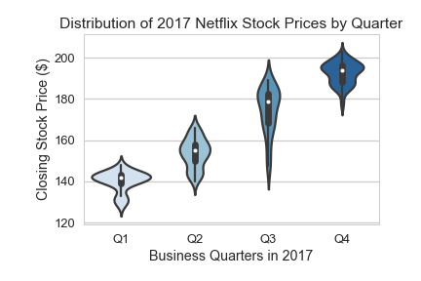
Distribution of 2017 NFLX stock prices
Stock prices had the most fluctuation in Q3 (Low:$146.17 – High:$189.08
Lowest price in 2017: $127.49
Highest price in 2017: $202.68
Overall prices went up throughout the year.

Slide 4
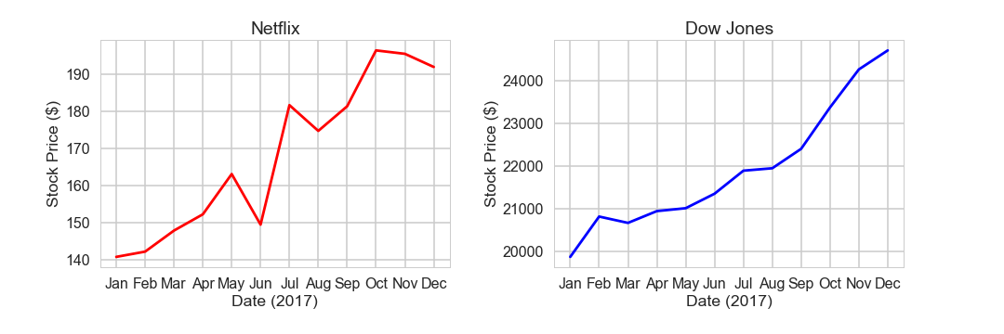
Netflix vs Dow Jones Stock Price
We can see Netflix is much much more volatile by the price changes between May and August.
Netflix outperformed the Dow Jones (58.98% vs 24.44% growth rate)

Slide 5
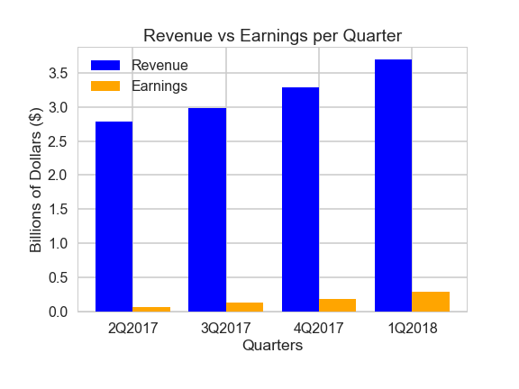
Revenue Vs earnings per quarter
Both Revenue and Earnings increased over all four quarters.
32.62% Revenue growth
37.38% Earnings growth
Earnings constituted for approx. 5.04% of Revenue.

Slide 6
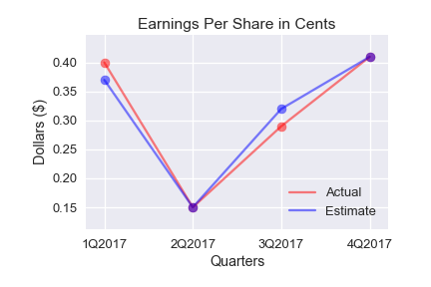
Earnings per share in cents
Estimations were for the most part accurate (within 3 cents of actual earnings in two quarters).
Earnings % of Revenue throughout the quarters:
Q1: 2.34%
Q2: 4.45%
Q3: 5.64%
Q4: 7.84%

